Slide 1
Object Oriented Programming (Introduction to Programming) Manuel Mazzara
Lecture 11a: More on
Multiple Inheritance

Slide 2
Introduction
Inheritance comes in two flavors: single and multiple
Multiple inheritance is sometime described in literature as “bad”
If it is done right, that is not true
Moreover, if used properly it will quickly become an indispensable part of your bag of tools

Slide 3
Examples of multiple inheritance
Combining separate abstractions:
Restaurant, train car
Calculator, watch
Home, vehicle
Car, public transport
...

Slide 4
Composite figures
Notes:
Example of grouping figures in Power Point, where you can treat several items as a single element

Slide 5
Multiple inheritance: Composite figures
Simple figures
A composite figure

Slide 6
Defining the notion of composite figure
center
display
hide
rotate
move
…
LIST [FIGURE ]
FIGURE
count
put
remove
…
COMPOSITE_FIGURE
Notes:
A composite figure is both a figure and a list of figures (or set, for example). This is an example of multiple inheritance.

Slide 7
In the overall structure
LIST [FIGURE ]
FIGURE
OPEN_ FIGURE
CLOSED_ FIGURE
perimeter*
SEGMENT
POLY
LINE
COMPOSITE_FIGURE
POLYGON
ELLIPSE
perimeter⁺
perimeter⁺
RECTANGLE
CIRCLE
TRIANGLE
perimeter⁺⁺
perimeter⁺⁺
diagonal
SQUARE
perimeter⁺⁺
Notes:
7

Slide 8
A composite figure as a list
after
item
forth
Cursor

Slide 9
Composite figures
Not necessarily the same function (i.e., no recursion)
class COMPOSITE_FIGURE inherit
FIGURE
LIST [FIGURE]
feature
display
-- Display each constituent figure in turn. do from start until after loop item.display
forth end end
... Similarly for move, rotate etc. ...
end
Requires dynamic binding
Notes:
In the example of the bicycle, the wheels are themselves composite figures, so the “display” call would be recursive, but in general it is not

Slide 10
Multiple inheritance: name clashes
f
A
B
f
C
?
Notes:
As soon as we enable multiple inheritance name clashes

Slide 11
The mapping
Names
Features
f
g
h
Notes:
In other languages (e.g., Java) there is the notion of overloading, allowing several functions to share the same name

Slide 12
Multiple inheritance: name clashes
f
A
B
f
C
?
Notes:
As soon as we enable multiple inheritance name clashes

Slide 13
Resolving name clashes
f
A
B
f
rename f as A_f
C
A_f, f

Slide 14
Consequences of renaming
a1 : A
b1 : B
c1 : C
...
c1.f
c1.A_f
a1.f
b1.f
f
A
B
f
rename f as A_f
C
A_f, f
Invalid:
a1.A_f
b1.A_f

Slide 15
Renaming and redefinition
For an inherited feature:
Redefining changes the feature, keeps its name
Renaming changes the name, keeps the feature
We can combine these mechanisms:
class A inherit
B
rename f as g redefine g end
…

Slide 16
What we have seen
We should distinguish between features and feature names
A class establishes a correspondence between names and features. For every name there should be at most one feature in the class
Multiple inheritance might threaten that property; renaming solves the problem

Slide 17
The mapping
Names
Features
f
g
h
Notes:
The thing to keep in mind is the relationship between feature names and features

Slide 18
Feature merging
f *
A
f *
B
C
f ⁺
D
∗ Deferred
⁺ Effective
Notes:
Let’s assume that the signature (name and number/types of arguments) is the same. Otherwise we won’t be able to reconcile.
The f from A and B will disappear

Slide 19
Feature merging: with different names
class
D
inherit
A rename
g as f
end
B
C rename
h as f
end
feature
...
end
A
g *
B
f *
C
h ⁺
g
f
h
f
∗ Deferred
⁺ Effective
Renaming
D
Notes:
The compiler won’t complain because in spite of two name clashes, 2 are deferred and 1 is effective.

Slide 20
Feature merging: effective features
f ⁺
A
f ⁺
B
C
f ⁺
f ⁻⁻
f ⁻⁻
∗ Deferred
⁺ Effective
⁻⁻ Undefine
D
Notes:
Undefine: make them deferred

Slide 21
Undefinition
deferred class
T
inherit
S
undefine v end
feature
...
end

Slide 22
Merging through undefinition
f ⁺
A
f ⁺
B
C
f ⁺
class
D
inherit
A undefine f end
B
C
undefine f end
feature
...
end
f ⁻⁻
f ⁻⁻
D
∗ Deferred
⁺ Effective
⁻⁻ Undefine

Slide 23
Merging effective features with different names
f ⁺
A
g ⁺
B
h ⁺
C
class
D
inherit
A
undefine f end
B
rename
g as f
undefine f
end
C
rename
h as f
end
feature ... end
g
f
f ⁻⁻
f ⁻⁻
h
f
D
Notes:
23

Slide 24
Acceptable name clashes
If inherited features have all the same names, there is no harmful name clash if:
They all have compatible signatures
At most one of them is effective
Semantics of such a case:
Merge all features into one
If there is an effective feature, it imposes its implementation
Notes:
24
From before

Slide 25
Feature merging: effective features
a1: A b1: B c1: C d1: D
a1.g b1.f c1.h d1.f
g+
A
f+
B
h+
C
g f
h f
D
f-
f-
Notes:
Let’s assume that thanks to polymorphism all the variables a1, b1, c1 and d1 are attached to the same object
a1 := d1; b1 := d1; c1 := d1

Slide 26
Sharing and replication
f
g
A
g g_b
g g_c
B
C
D
Features such as f, not renamed along any of the inheritance paths, will be shared.
Features such as g, inherited under different names, will be replicated.

Slide 27
What we have seen so far
Games we can play with features and their names:
renaming
redefinition
undefinition
merging
…
Very useful for library building!
The key rule remains: one name, one feature
Notes:
renaming, redefinition, undefinition are language features

Slide 28
Object Oriented Programming (Introduction to Programming) Manuel Mazzara
Lecture 11b: Basic Data Structures and Genericity

Slide 29
Container data structures
Contain other objects (elements, items)
Most fundamental operations on a container:
Insert an item
Access an item
Remove an item
Some containers have indexes or keys associated with items
Different containers provide different flavors of the fundamental operations and with different efficiency

Slide 30
Basic containers
Array
List
array-based implementation
linked implementation
Stack
Queue
Table (dictionary, associative array)
hash table

Slide 31
Arrays
An array is a container storing items in contiguous memory locations, each identified by an integer index
insertion/removal works by putting items into the existing slots and resizing the array as needed
lower
item (4 )
upper
1
2
3
4
5
6
7
Valid index values

Slide 32
Caveat
Whenever you define a container structure and the corresponding class, pay attention to borderline cases:
Empty structure
Full structure (if finite capacity)

Slide 33
Resizing an array
At any point in time arrays have a fixed lower and upper bound, and thus a fixed capacity
Unlike most other programming languages, Eiffel allows resizing an array (resize)
Feature force resizes an array if required: unlike put, it has no precondition
Resizing usually requires reallocating the array and copying the old values. Such operations are costly!

Slide 34
Array operations
Operation | Eiffel example | Efficiency
Access by index | a.item (4) a [4] | fast
Replace at index (index within bounds) | a.put (“hello”, 4) a [4] := “hello” | fast
Resize | a.resize (1, 10) | slow (when growing)
Resize + replace | a.force (“hello”, 10) | slow (when growing)
a
1
2
3
4
5
6
7

Slide 35
Lists
A list is a container storing items, identified by an integer index, where items can be inserted or removed at any position
Two implementations: array-based vs. linked
extend_at (“hello”, 3 )
remove_at (6 )
item (4 )
1
2
3
4
5
6
7
count

Slide 36
Arrayed list
Stores list items in the first count cells of an array
Moves items over when inserting/removing in the middle
Resizes the array when runs out of space
count
capacity
1
2
3
4
5
6
7
1
2
3
4
5
6
7
count =
capacity
1
2
3
4
5
6
7
8
9
10

Slide 37
Arrayed list operations
Operation | Eiffel example | Efficiency
Access by index | l.item (4) or l [4] | fast
Inserting at the end | l.extend_back (“hi”) | fast (when not growing)
Inserting at the front | l.extend_front (“hi”) | slow (can be made fast)
Inserting in the middle | l.extend_at (“hi”, 5) | slow
Removing at the end | l.remove_back | fast
Removing at the front | l.remove_front | slow (can be made fast)
Removing in the middle | l.remove_at (5) | slow

Slide 38
(Singly) Linked list
Stores each item in a cell, which knows where to look for the next cell
No direct access by index; to point to an item use a cursor, which moves left to right
Once the position is found, inserting/removing in the middle is easy
right
right
right
right
first
“...”
“hi”
“...”
“...”
Void
cursor.item
“...”
“...”
“...”
“...”
“...”
“...”

Slide 39
Singly-linked list operations
Operation | Eiffel example | Efficiency
Access by index | l.item (4) or l [4] | slow
Inserting at the end | l.extend_back (“hi”) | slow (can be made fast)
Inserting at the front | l.extend_front (“hi”) | fast
Inserting after the cursor | cur.extend_right (“hi”) | fast
Removing at the end | l.remove_back | slow
Removing at the front | l.remove_front | fast
Removing after the cursor | cur.remove_right | fast

Slide 40
Linked or arrayed list?
The choice of a container data structure depends on the speed of its container operations
The speed of a container operation depends on how it is implemented, on its underlying algorithm
Notes:
We are coming closer to answering the ultimate question. The answer will depend on the requirements for a given application or algorithm which use the data structure. What kind of operation is performed most often? Are elements accessed in sequence or randomly? Are elements sorted? Is the number of elements constant? If it isn’t, is the maximum number fixed? Etc. etc.

Slide 41
How fast is an algorithm?
Depends on the hardware, operating system, load on the machine...
But most fundamentally depends on the algorithm!
Notes:
So, we want speed.

Slide 42
Basic containers
Array
List
array-based implementation
linked implementation
Stack
Queue
Table (dictionary, associative array)
hash table
Notes:
There are many containers and we will only look at a couple

Slide 43
Stacks
In a stack you cannot access or remove any stored item as you please (e.g. by index), but only the most recently added item, also called top
we say that stacks prescribe a Last-In-First-Out (LIFO) retrieval policy
Useful when traversing a hierarchical structure
Can be implemented with an array or a singly-linked list
capacity
top
top
right
right

Slide 44
Applications of stacks
Many!
Ubiquitous in programming language implementation:
Parsing expressions (see next)
Managing execution of routines (“THE stack”) Special case: implementing recursion
Traversing trees
…

Slide 45
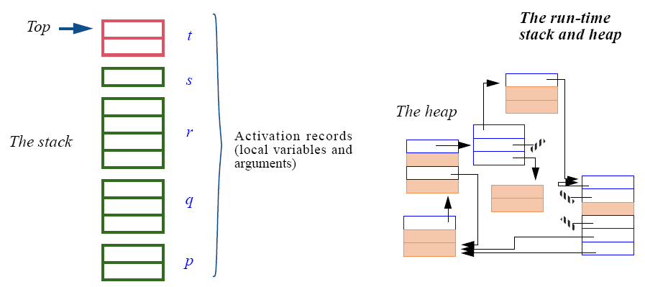
The run-time stack
The run-time stack contains the activation records for all currently active routines.
An activation record contains a routine’s locals (arguments and local entities).

Slide 46
Stack operations
Operation | Eiffel example | Efficiency
Access top | s.item | fast
Push on top | s.extend (“hi”) | fast
Pop from the top | s.remove | fast

Slide 47
Queues
In a queue you can only add items to its tail, and only access and remove items from its front
we say that queues prescribe a First-In-First-Out (FIFO) retrieval policy
Useful when processing events in a fair way
Can be implemented with an array (ring buffer) or a singly-linked list (with a reference to the last cell)
tail
front
right
front
right
tail

Slide 48
Queue operations
Operation | Eiffel example | Efficiency
Access front | q.item | fast
Enqueue | q.extend (“hi”) | fast
Dequeue | q.remove | fast

Slide 49
Basic containers
Array
List
array-based implementation
linked implementation
Stack
Queue
Table (dictionary, associative array)
hash table

Slide 50
Tables
Can we access items efficiently
Constant-time access
Constant-time update
without limiting ourselves to keys that are integers in a fixed, contiguous interval?
e.g. index contacts in the address book by name
Hash table answer: almost!

Slide 51
Hash table
Idea: map all possible keys K into an integer interval 1..n and then store the items in an array
would work if each key mapped to a different index
usually there are more keys then indexes, which inevitably leads to collisions
K
hash code
1
“Bertrand Meyer”
hash function
2
3
“079 ...”
collision!
4
“Barack Obama”
5
6
Notes:
A perfect hash function gives a different integer value for every element of K.
Whenever two different keys give the same hash value a collision occurs.
The underlying data structure is an array, so keys must be somehow translated into indexes.
(Show how it works.)
If the hash function is perfect, insertion and search are O (1).
Collisions reduce the efficiency; worst-case insertion and search O (count).

Slide 52

A mapping structure

Slide 53
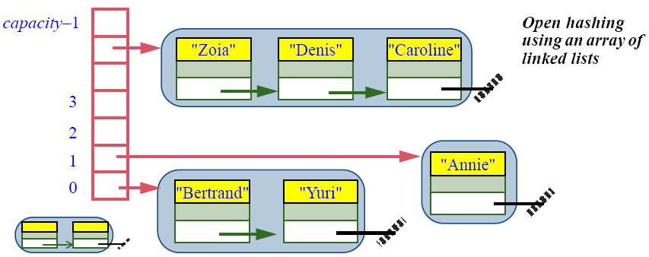
Collision handling I: Open Hashing
Open hashing:
ARRAY [LINKED_LIST [G]]
Notes:
All items with the same hash code are stored in a linked list.
An access requires the hashing of a key into an array index, then a sequential search in the associated list.
The cost of such a collision can be in the worst case linear.

Slide 54
Collision handling II: Closed Hashing
With closed hashing if the array position i is already occupied we try a back-up plan (e.g. i + 2) until we find a free position
to access by key: try the same sequence of positions
1
key
item
2
“Lionel Messi”
item
3
“Cristiamo Ronaldo”
item
4
5
key
item
Notes:
If the hash function yields an already occupied position, the mechanism will try a succession of other positions (i1, i2, i3) until it finds a free one.
With this policy and a good choice of hash function search and insertion in a hash table are essentially O (1).

Slide 55
Hash table operations
Operation | Eiffel example | Efficiency
Access by key | t.item (“key”) t [“key”] | fast*
Replace at key | t.put (..., “key”) t.force (..., “key”) t [“key”] := ... | fast*
Insert with key | t.extend (..., “key”) t.force (..., “key”) t [“key”] := ... | fast*
Remove at key | a.remove (“key”) | fast*
* Can get slow if the array is too small or the hash function is bad (i.e. maps everything to the same index)

Slide 56
Choosing between data structures
Use a linked list if:
Order between items matters
The main way to access them is in that order
(Bonus condition) No hardwired size limit
Use an array if:
Each item can be identified by an integer index
The main way to access items is through that index
Hardwired size limit (at least for long spans of execution)
Use a hash table if:
Every item has an associated key
The main way to access them is through these keys
The structure is bounded
Use a stack:
For a LIFO policy
Example: traversal of nested structures such as trees
Use a queue:
For a FIFO policy
Example: simulation of FIFO phenomenon

Slide 57
Extending the basic notion of class
Inheritance
Abstraction
SET_OF_CARS
Genericity
Type parameterization
Type parameterization
LIST_OF_ CITIES
LIST_OF_CARS
LIST_OF_
PERSONS
LINKED_LIST_OF_CARS
Specialization
Notes:
57

Slide 58
Extending the basic notion of class
Inheritance
SET_OF_ PERSONS
SET_OF_CARS
Genericity
LIST_OF_ CITIES
LIST_OF_CARS
LIST_OF_
PERSONS
LINKED_LIST_ OF_CITIES
LINKED_LIST_OF_CARS
Notes:
58

Slide 59
Genericity: ensuring type safety
How can we define consistent “container” data structures, e.g. list of accounts, list of points?
Without genericity, something like this:
c : CITY ; p : PERSON cities : LIST ...
people : LIST ...
---------------------------------------------------------
people.extend ( c )
cities.extend ( p )
c := cities.last
c.some_city_operation
What if wrong?

Slide 60
Possible approaches
1. Duplicate code, manually or with help of macro processor
2. Wait until run time; if types don’t match, trigger a run-time failure (Smalltalk)
3. Convert (“cast”) all values to a universal type, such as “pointer to void” in C
4. Parameterize the class, giving an explicit name G to the type of container elements. This is the Eiffel approach, also found in recent versions of Java, .NET and others.

Slide 61
In a sad world
Imagine we wanted to represent a list of cities and a list of people, we’d have to write this:
class CITY_LIST
feature
extend (x: CITY)
do … end
item (i: INTEGER): CITY
do … end
class PERSON_LIST
feature
extend (x: PERSON)
do … end
item (i: INTEGER): PERSON
do … end
Can we do better?

Slide 62
What we would like to do
This shouldn’t be so hard! Let’s look again at what we really want:
class _LIST
feature
extend (x: )
do … end
item (i: INTEGER):
do … end
We just want to have a class that has some “holes” in it that we can fill in later with whatever type we like!

Slide 63
How it looks in Eiffel
Let’s not despair: we know how to do this, we’ve done it for years! We just use a parameter, as we would in any other function. Eiffel calls this the formal generic parameter.
class LIST [G]
feature
extend (x: G)
do … end
item (i: INTEGER): G
do … end
Introducing the parameter
f(x) = x + 1
Using the parameter

Slide 64
Generics in practice
Finally, we can do what wanted to begin with, substituting the actual generic parameter for the formal one:
cities: LIST [CITY]
people: LIST [PERSON]
bern: CITY
fred: PERSON
…
cities.extend (bern)
people.extend (fred)
Now:
We have type safety (we cannot put a city into the list of people and vice versa)
We don’t have to write a new LIST implementation for every type of thing we want to put in it.

Slide 65
Constrained genericity (1)
Previously we just had G and it could be anything. Sometimes we only want certain kinds of types to fill that hole.
class SORTED_LIST
[G -> COMPARABLE]
feature
extend (x: G) do … end
item (i: INTEGER): G do … end
sort do … end
This can only be instantiated with a G that is also COMPARABLE, because this is necessary to implement the sort routine.

Slide 66
Constrained genericity (2)
Constrained genericity does two things for us:
It states that any candidate for substitution for G must conform to class COMPARABLE. Typically this means it must inherit from COMPARABLE
It allows, within the features of SORTED_LIST, the features of COMPARABLE to be applied to any item which has a type of G.

Slide 67
What we have seen
Basic container data structures
arrays and lists
stacks and queues
tables
For each data structure:
Which operations does it support?
Which operations are efficient and which are slow?
Implementation in a nutshell
There is no one best container: choose the one that matches your problem!
Containers and genericity
Notes:
Genericity lets us:
Have classes that are parameterized by type(s). I.e., we put CITY into a LIST [CITY] the type system tells us we get a CITY back out. If we upcast everything to ANY, ironically, we know nothing.
Write only one class to get the benefits of the above point. We just have to write a single class with a formal generic parameter (“hole”) that we will instantiate with the actual generic parameter later.

